Slide 1
Team PRINT Updates
Composite Conformal Printing

Slide 2
Overview of Changes
Changes since last official presentation:
Reducing scope to exclude robotic arm and scanning
Simplifications/Modifications:
Analyzing types of damages closer
More defensible test beds
3-Axis printing
Shorter lead time
Existing software
Experimentation
Structural and composite analysis

Slide 3
How effective is repairing FFF 3D printed structures with conformal FFF 3D printing?

Slide 4
Previous Work

Slide 5
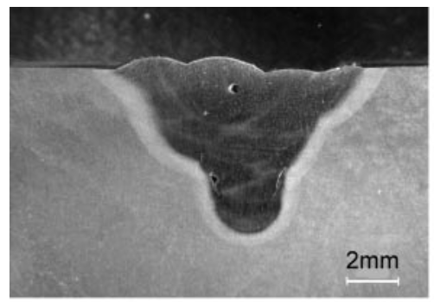
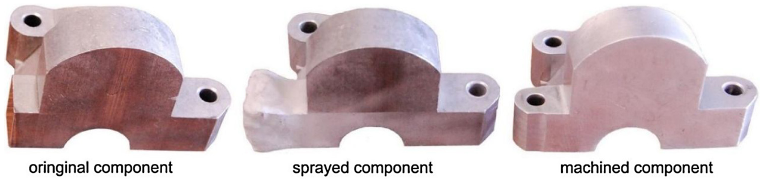
Existing Methods of AM Repairs
Direct Energy Deposition (DED) or Laser Metal Deposition (LMD)
Metal powder is injected and fused onto damaged surface using a high power laser as a heat source
Cold Spray Additive Manufacturing (CSAM)
Metal powder is injected at high enough velocity to fuse together from impact
Both are promising methods for repairing damaged components, but both still have issues
Rapid heating and cooling in the DED process can cause small defects within the deposited material impacting mechanical properties
CSAM repairs require machining the surface prior to and after deposition to ensure a smooth surface
[1]
[2]

Slide 6
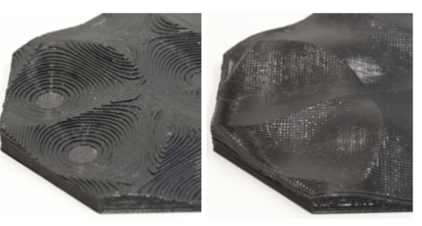
Nonplanar 3D Printing
University of Hamburg
Nonplanar printing used for smoother top surface
Algorithm used to detect collisions
Printhead raised above nearby layers and continued planar printing
Toolpath
Potential non planar regions identified by code
Top layers moved upward to highest possible point
Projection of the layer used to create non planar toolpath
University of Southern California
6 DOF Robotic Arm used for concave and convex printing
Speed of printhead and extrusion changed for uniform layer thickness
[3]

Slide 7
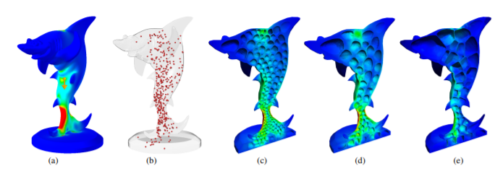
Structure of repairs
Honeycomb
Provides optimal strength to weight ratio
May be hard to replicate, would be great to have in lit review but might be impractical for initial tests
Uses minimal material while maintaining structural integrity
Trusses may be an easier method to demonstrate the capability to save material and time while still increasing strength to weight ratio
[4]

Slide 8
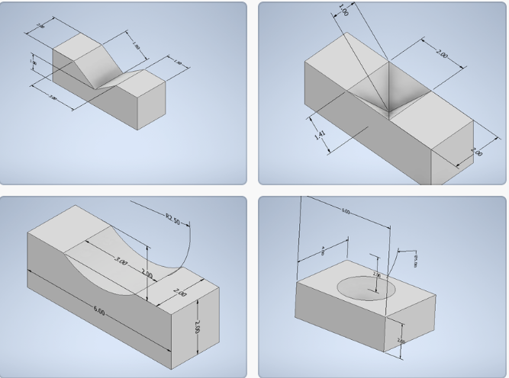
Methodology
First for each model we would make multiple groups: undamaged, only damaged, and damaged then repaired with our 3D printer
Second we would conformly print in the ones needed to be repaired
Lastly we would then test each group with different stress and strain tests

Slide 9
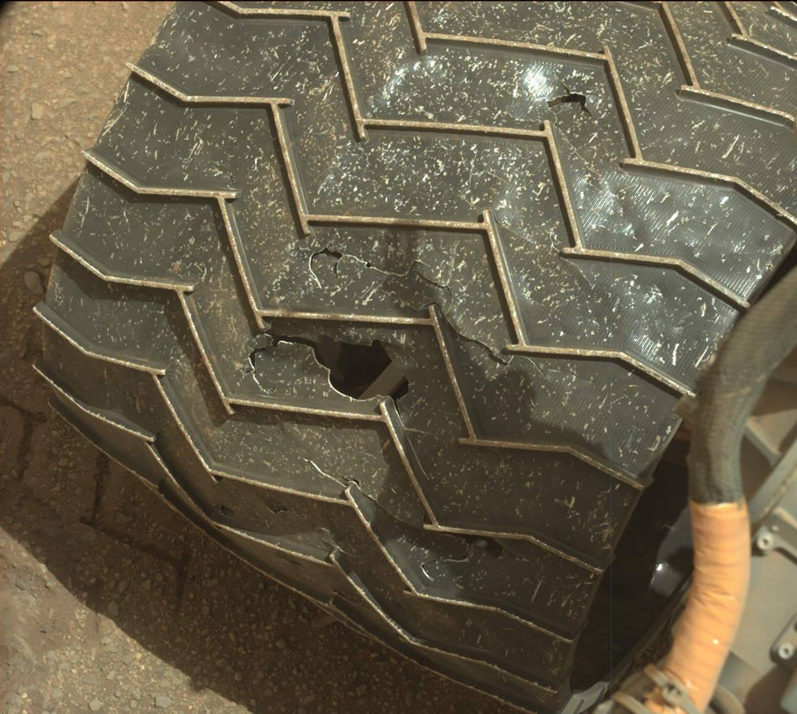
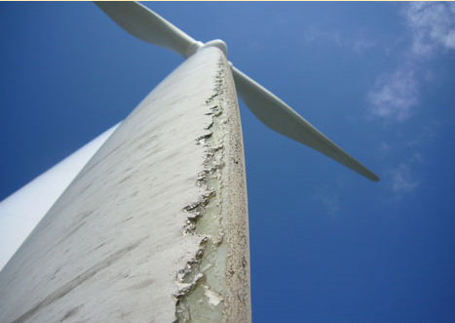
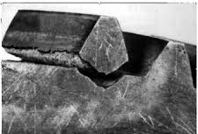
Testing Structure Defense
Decided on the design of our conformal printing test structures using potential real-world applications
Satellite servicing and extraterrestrial rover repair
NASA’s Curiosity Mars rover sustained tire damage (1-3 inch long tears)
3D-printed Rutherford rocket engine
Carbon fiber bike frames
Gears, brackets, hoses on the ISS
Windmill damage
[7]

Slide 10
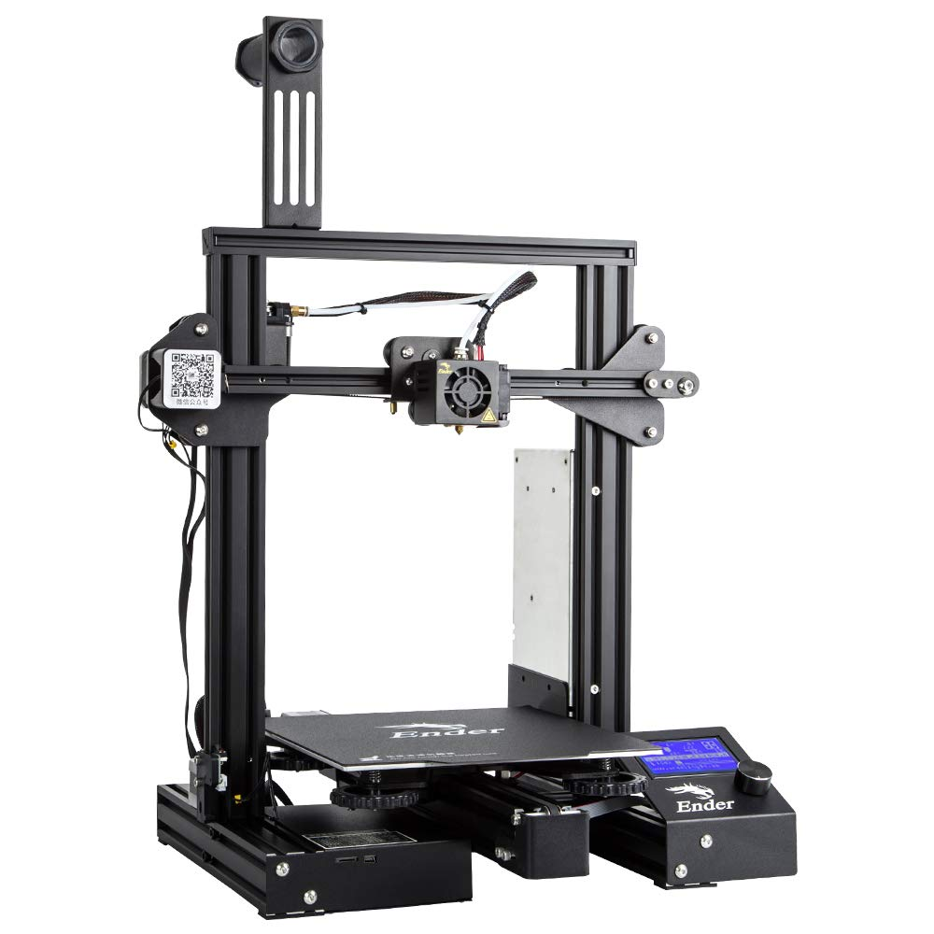
3D printer
We have chosen the Ender 3 Pro as the best printer for the job as it meets all the criteria
Inexpensive (236 dollars)
Meets all software criteria
Nozzle sticks out
Large print platform (220 x 220 x 250mm)
High quality prints
Great reviews
[6]

Slide 11

Project Management

Slide 12
Progress Update

Slide 13
Experimentation

Slide 14
Procedure Plan
Flexural Test For A Generic Sample (D790)
Clean bottom side of part with alcohol
Glue strain gauge onto part
Strain gauge will be mounted to bottom of specimen directly below loading point
Place part onto press
Part will be supported on either end by D-shafts secured to the press with glue and clamps
S-type load cell will be attached to the press rod, measuring total force on part
Run arduino code to monitor loads and strain
Press (with strain rate of 0.10 mm/mm/min) until a maximum of 5% strain is reached or until rupture occurs on part
Since press is hand-operated, proper press rate will be estimated by monitoring strain, force, and/or displacement rate as it is being pressed
While pressing use video and ruler to record displacement of press
Force, strain, and displacement data will be used to create stress/strain curves, determine strength-to-weight ratio, and create force vs displacement graphs

Slide 15
Sample Spec

Slide 16
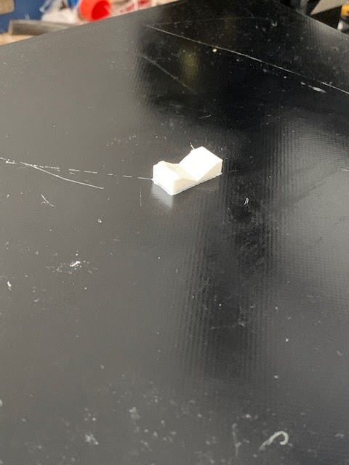
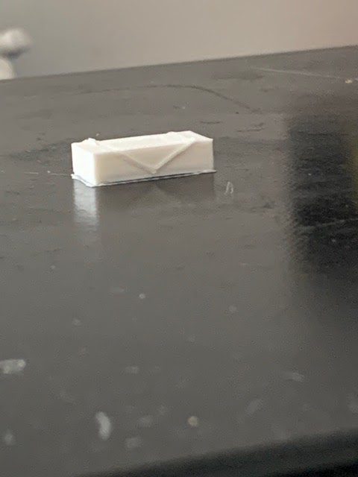
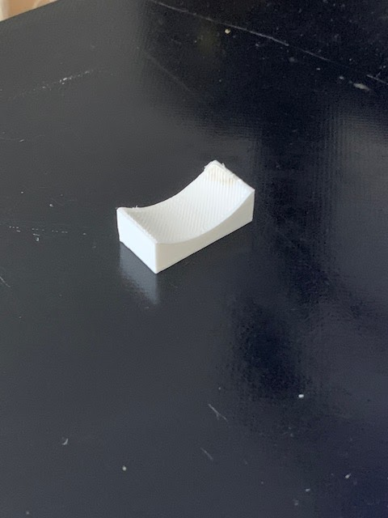
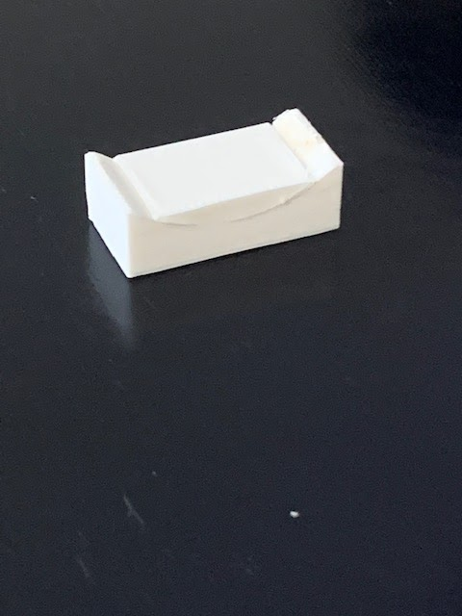
Insitu conformal print pictures
Before
After
Before
After
T1 design
T3 design

Slide 17
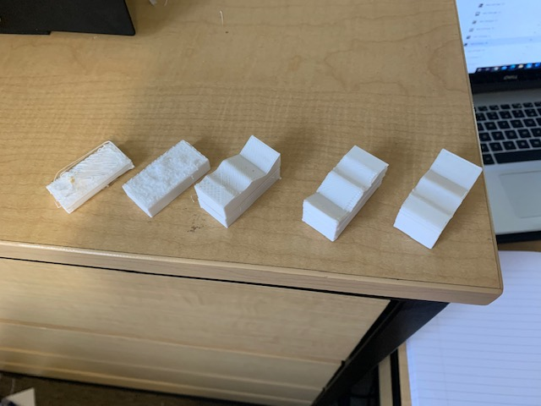
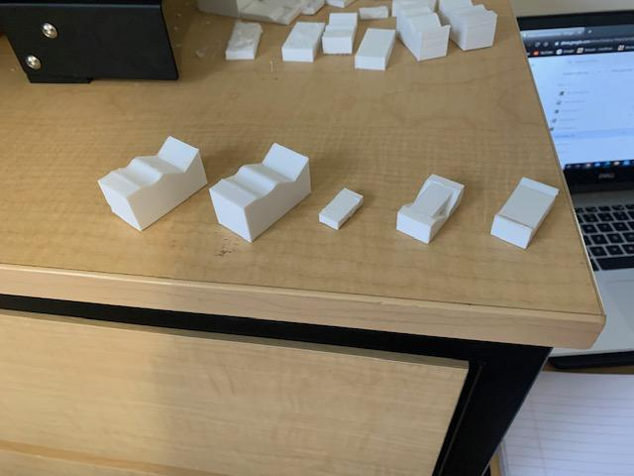
Progression of prints
To large layer
Height (.2 mm, 20% infill) part 1
To large layer
Height (.2 mm, 20% infill) part 2
To large layer
Height (.16 mm, 20% infill)
Belt became unstable (.12 mm, 20% infill)
Perfect (.12 mm, 20% infill)
Corner raised (fixed by closing window and using hairspray) (.12 mm, 100% infill)
Perfect (.12 mm, 100% infill)
Insitu conformal print, T1 small (.12 mm, 100% infill)
Insitu conformal print, T1 big (.12 mm, 100% infill)
Insitu conformal print, T3 big (.12 mm, 100% infill)

Slide 18

Videos of printing
Conformal printing to get rid of staircase effect
Printing in situ to fill in print

Slide 19
Slicer Development

Slide 20
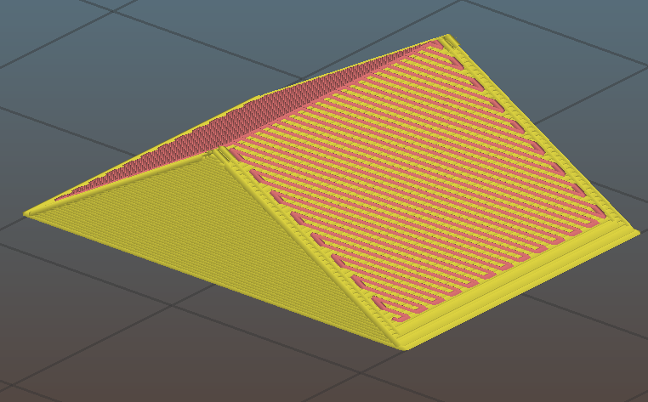
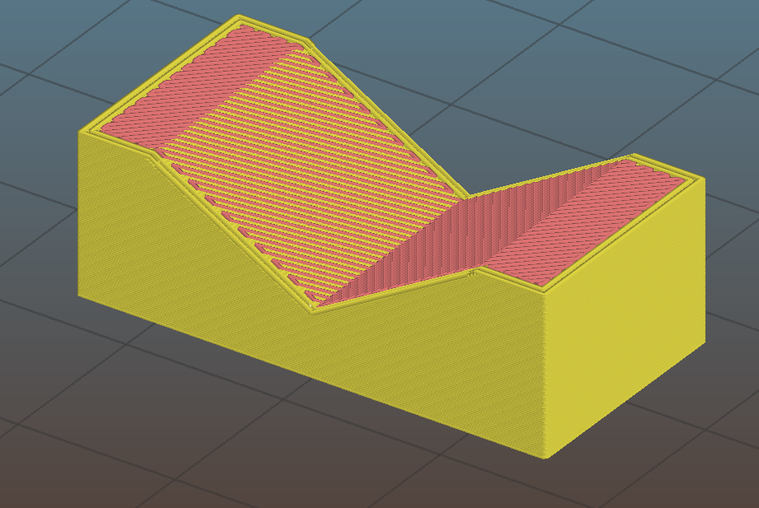
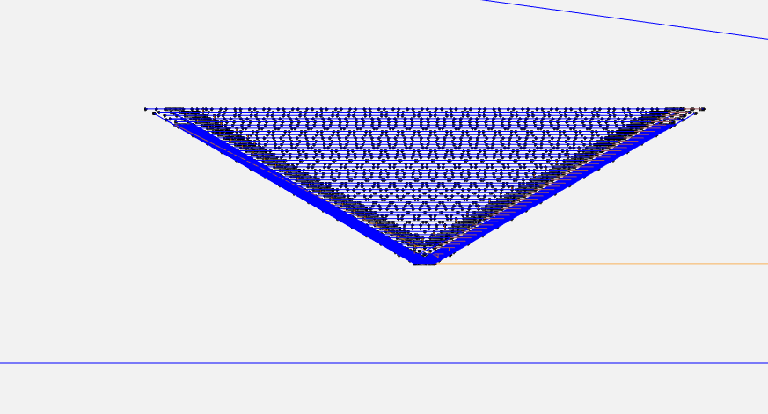
It works

Slide 21
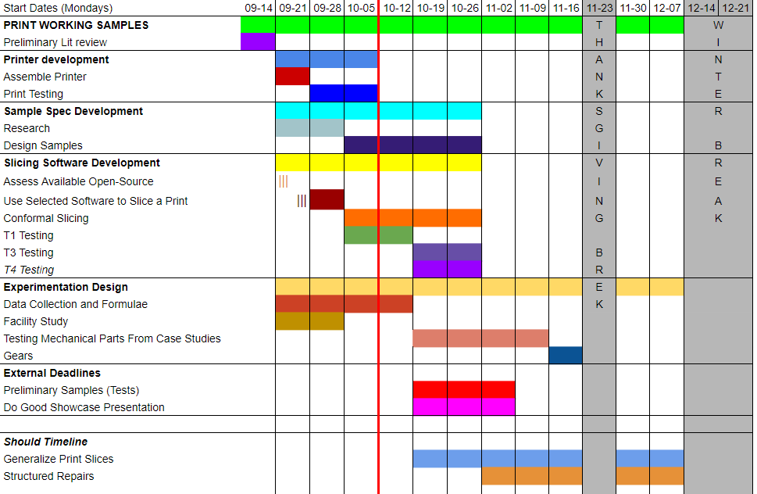
Timeline

Slide 22
References
[1] A. J. Pinkerton, W. Wang, and L. Li, “Component repair using laser direct metal deposition,” Proceedings of the Institution of Mechanical Engineers, Part B: Journal of Engineering Manufacture, vol. 222, no. 7, pp. 827–836, Jul. 2008, doi: 10.1243/09544054JEM1008.
[2] S. Yin et al., “Cold spray additive manufacturing and repair: Fundamentals and applications,” Additive Manufacturing, vol. 21, pp. 628–650, May 2018, doi: 10.1016/j.addma.2018.04.017.
[3] “(PDF) 3D Printing of Nonplanar Layers for Smooth Surface Generation,” ResearchGate. https://www.researchgate.net/publication/335542750_3D_Printing_of_Nonplanar_Layers_for_Smooth_Surface_Generation (accessed Sep. 03, 2020).
[4] L. Lu et al., “Build-to-last: strength to weight 3D printed objects,” ACM Trans. Graph., vol. 33, no. 4, pp. 1–10, Jul. 2014, doi: 10.1145/2601097.2601168.
[5] M. Castilho, I. Pires, B. Gouveia, and J. Rodrigues, “Structural evaluation of scaffolds prototypes produced by three-dimensional printing,” Int J Adv Manuf Technol, vol. 56, no. 5–8, pp. 561–569, Sep. 2011, doi: 10.1007/s00170-011-3219-4.
[6] https://www.amazon.com/Comgrow-Creality-Printer-Upgrade-Certified/dp/B07GYRQVYV/
[7] NASA/JPL-Caltech/MSSS, Sol 962: Mast Camera (Mastcam). 2015.

